Slide 1

Fundamentals of IT Security
Abebe A.

Slide 2
Goals
Provide an introduction to computer/Information security
Overview security threats and defenses in cyber and physical systems
Help you develop a security-aware mindset

Slide 3
Course Staff
Lecture
Lab – Salem

Slide 4
Lectures
Introduction
Fundamental Concepts
Cryptographic concepts
Network Security
Web Security
OS Security
physical Security

Slide 5
Assessment Method
Lab & Project Assessment (30 %)
Mid-Semester Examination (25%)
Assignments (15%)
Final Examination (30%)

Slide 6
Course Policies
Late Policy
No late submission of assignments, projects or lab activities, it will be penalized or may not be graded.
Collaboration Policy
Students are encouraged to collaborate, particularly on the course projects given for groups, however, every member should show his/her contribution on the work done.
Cheating Policy
The university policy on cheating and plagiarism will be strictly followed.

Slide 7
Introduction
What is Computer Security?
Allow intended use of computer systems
Prevent unwanted use that may cause harm

Slide 8
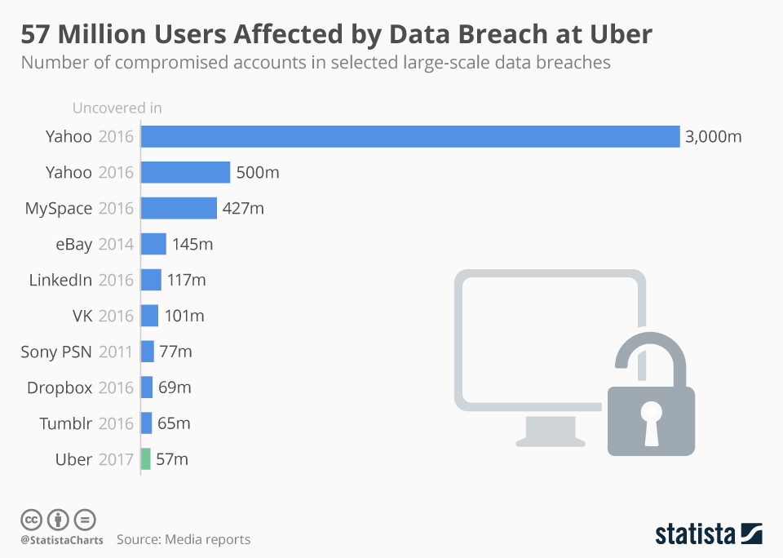
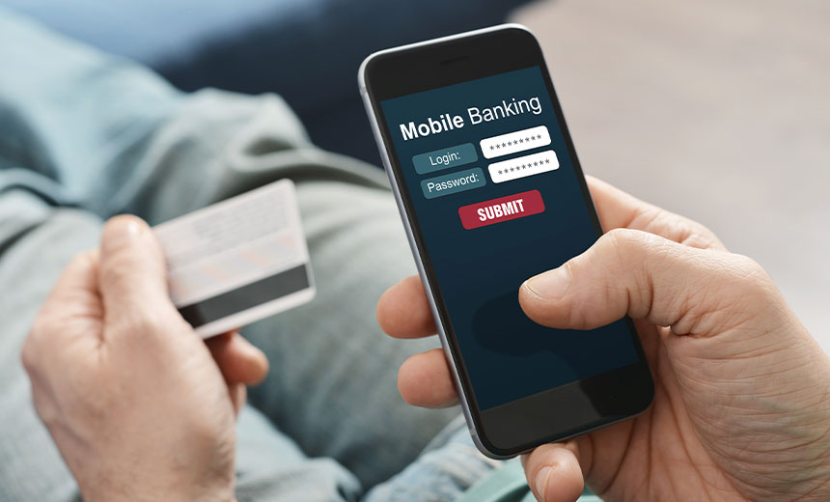
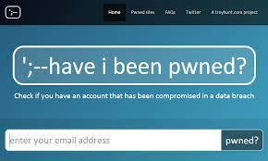
Why should you care?
Impacts everyone’s day-to-day life – Millions of compromised computers, millions of stolen passwords

Slide 9
Why should you care?
Good Security Standards follow the “90 / 10” Rule:
10% of security safeguards are technical
90% of security safeguards rely on the computer user (“YOU”) to adhere to good computing practices
A compromised computer is a hazard to everyone else, too – not just to you.
Learn About Security ➔ Make a Difference

Slide 10
A hacked computer can be used to…
Record keystrokes and steal passwords.
Send spam and phishing emails.
Harvest and sell email addresses and passwords.
Infect other systems.
Hide programs that launch attacks on other computers.
Illegally distribute music, movies and software.
Generate large volumes of traffic, slowing down the entire system.

Slide 11
Threats have evolved…
1990’s: bragging rights
late 2000’s: financially motivated
Spam, pharmaceuticals, credit card theft, identity theft
2010’s: politically motivated
Government actors: Stuxnet, Flame, Aurora
Private activism: Anonymous, Wikileaks
Attackers have become more sophisticated;
arms race between attackers and defenders fuels rapid innovation in malware

Slide 12
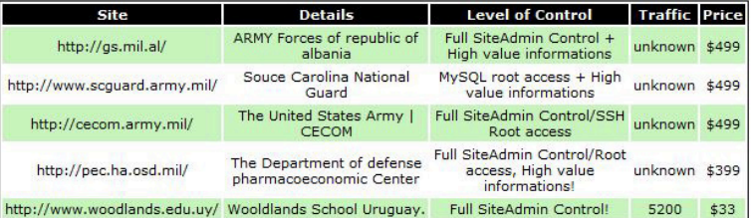
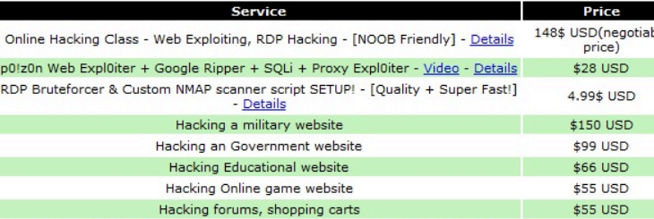
Threats have evolved…

Slide 13
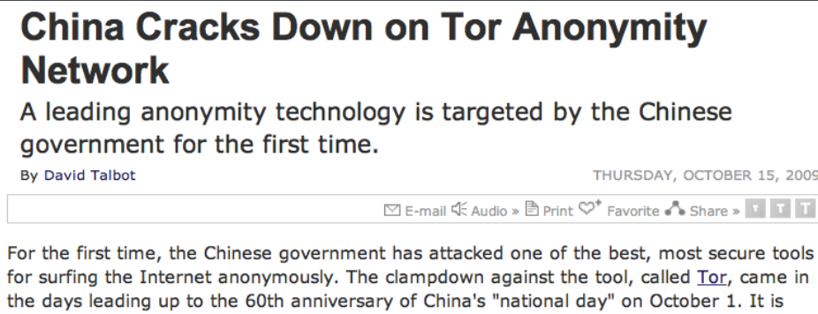
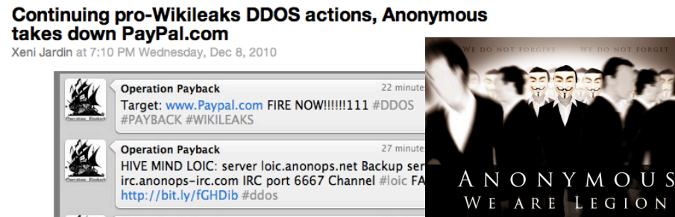
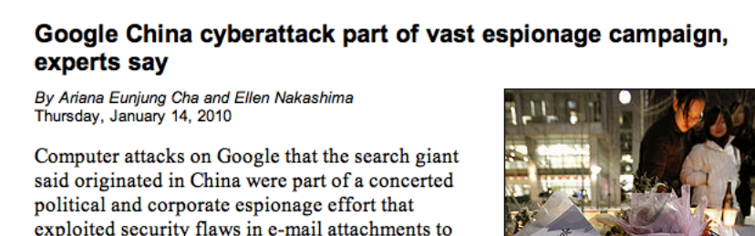
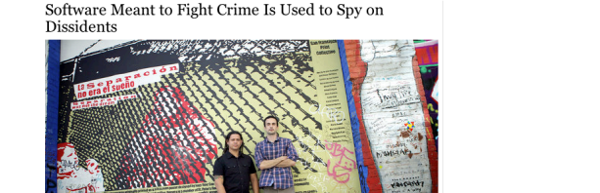
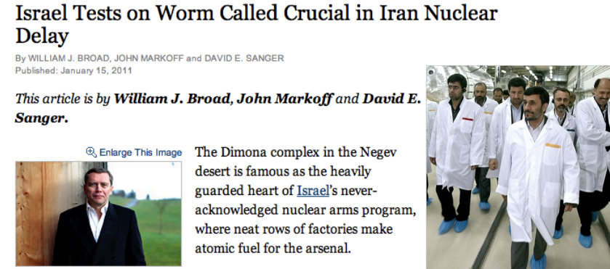

Slide 14
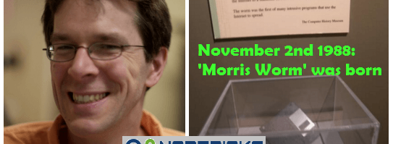
The first internet worm
The first Internet worm
Designed by Robert Morris
A grad student experimented (in the lab) with self-spreading malware
It got out of control.
Morris Worm is the first known ‘Distributed Denial of Service (DDoS)’ cyber attack
He was sentenced to 3 years probation, 400hours of community service and $10,000 fine.

Slide 15
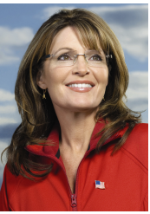
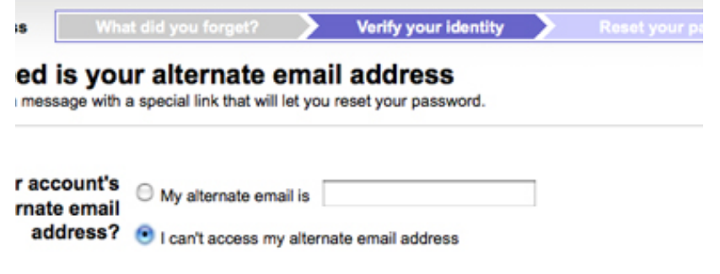
Epic Hack: Sarah Palin
Guy wants to mess with Sarah Palin’s campaign
Tries logging into her Yahoo Mail account, sees her security questions…

Slide 16
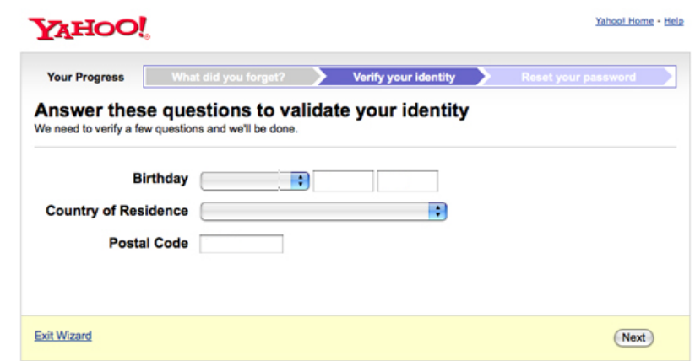
Sarah Palin

Slide 17
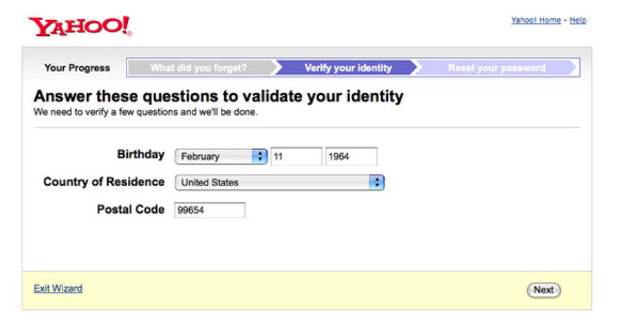
Sarah Palin

Slide 18
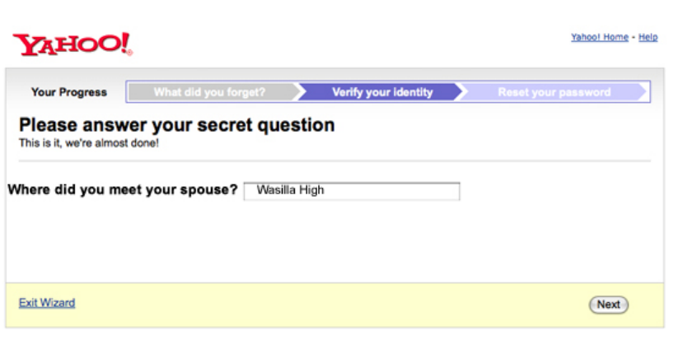
Sarah Palin

Slide 19
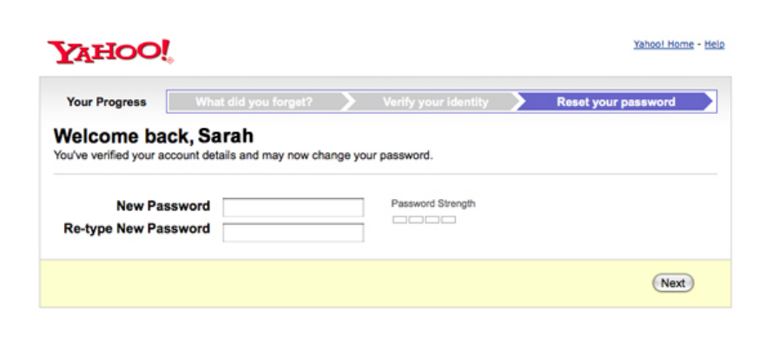
Sarah Palin

Slide 20
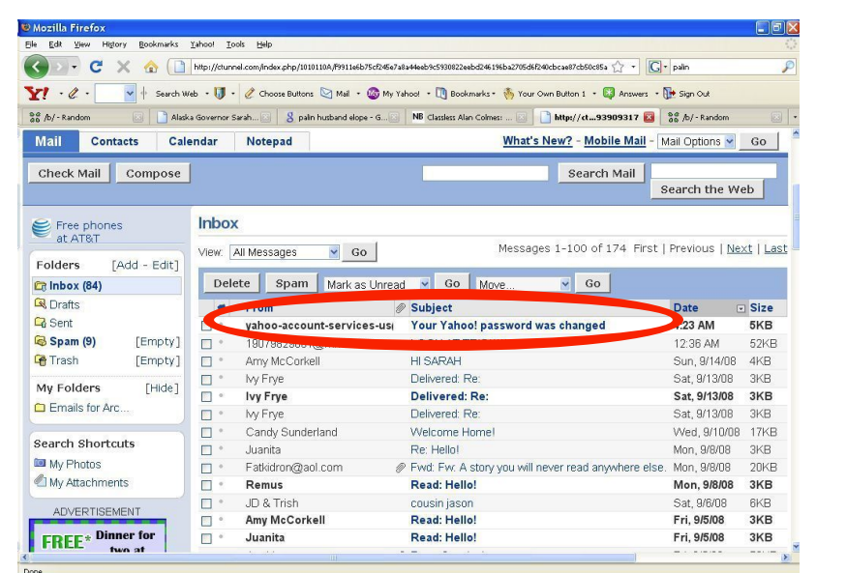
Sarah Palin

Slide 21
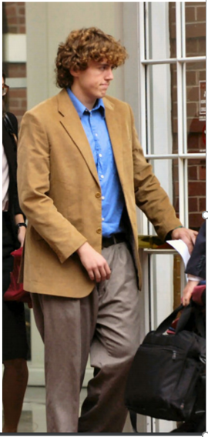
Sarah Palin
Sentenced to 1 year in federal prison.
in 2012, someone hacks Mitt Romney’s email account
… by guessing the name of his pet dog

Slide 22
How do we defend threats
High-level goal is risk management, not bulletproof protection.
Much of the effort concerns raising the bar and trading off resources
How to wisely spend your time & money?
Key notion of threat model:
What you are defending against, determines which defenses are worthwhile

Slide 23
Threat models
Basic model
Assets: what you want to protect
Threats: what could damage your assets
The goal is ensuring threats don’t damage assets

Slide 24
Ex. Air travel Scenario
Assets | Threats
Passengers Crew Luggage Aircraft | Engine failure Pilot failure Air Traffic Control failure Wind Ice

Slide 25
Ex. Air travel Scenario
Threats | Safety measures
Engine failure Pilot failure ATC failure Wind Ice | Two or more engines, maintenance Two or more pilots, rest periods, checklists Multiple communication protocols, automated collision avoidance systems Multiple runways, weather forecasting, Aircraft deicing systems

Slide 26
Safety vs security
Another threat to air travel
Terrorism
This type of threat is called an attacker
Intelligent
Motivated
Security is like safety, but it deals with attackers
Defending against attackers is more difficult than mitigating natural threats

Slide 27
Security Design
Evaluate risk
Capabilities of attackers
Likelihood of obtaining such capabilities
Identify defenses
Develop risk mitigation measures
Assess cost of such measures
Manage risk
Implement specific defenses considering risk and cost

Slide 28
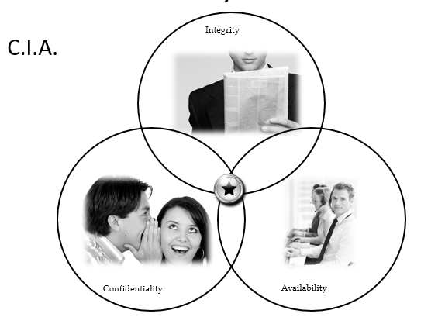
Security Goals
.

Slide 29
Confidentiality
Confidentiality is the avoidance of the unauthorized disclosure of information.
confidentiality involves the protection of data, providing access for those who are allowed to see it while disallowing others from learning anything about its content.
Keeping information secret is often at the heart of information security, and this concept, in fact, predates computer.
E.g. Julius Caesar – Caesar Cipher
Nowadays, achieving conﬁdentiality is more of a challenge
Additional tools needed for protecting sensitive information, any ideas?

Slide 30
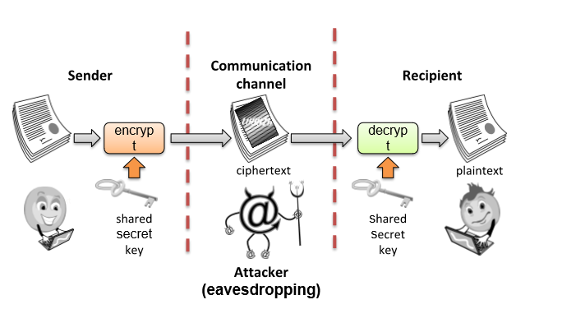
Tools for Confidentiality
Encryption: the transformation of information using a secret, called an encryption key, so that the transformed information can only be read using another secret, called the decryption key (which may, in some cases, be the same as the encryption key).

Slide 31
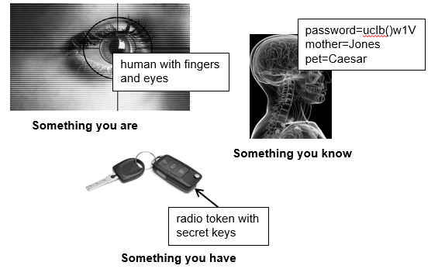
Tools for Confidentiality
Authentication: the determination of the identity, validating that users are whom they claim to be. This determination can be done in a number of different ways, but it is usually based on a combination of
something the person has (like a smart card or a radio key fob storing secret keys),
something the person knows (like a password),
something the person is (like a human with a fingerprint).
what is multi-factor authentication (MFA)?

Slide 32

Tools for Confidentiality
Access control (authorization): rules and policies that grants or denies users (systems) access to specific resource/function.
It could be determined by identity, such as a person’s name or a computer’s serial number, or by a role that a person has, such as being a manager or a computer security specialist.
What’s the difference between authorization and authentication? Which one do you think should comes first (give an example)?

Slide 33
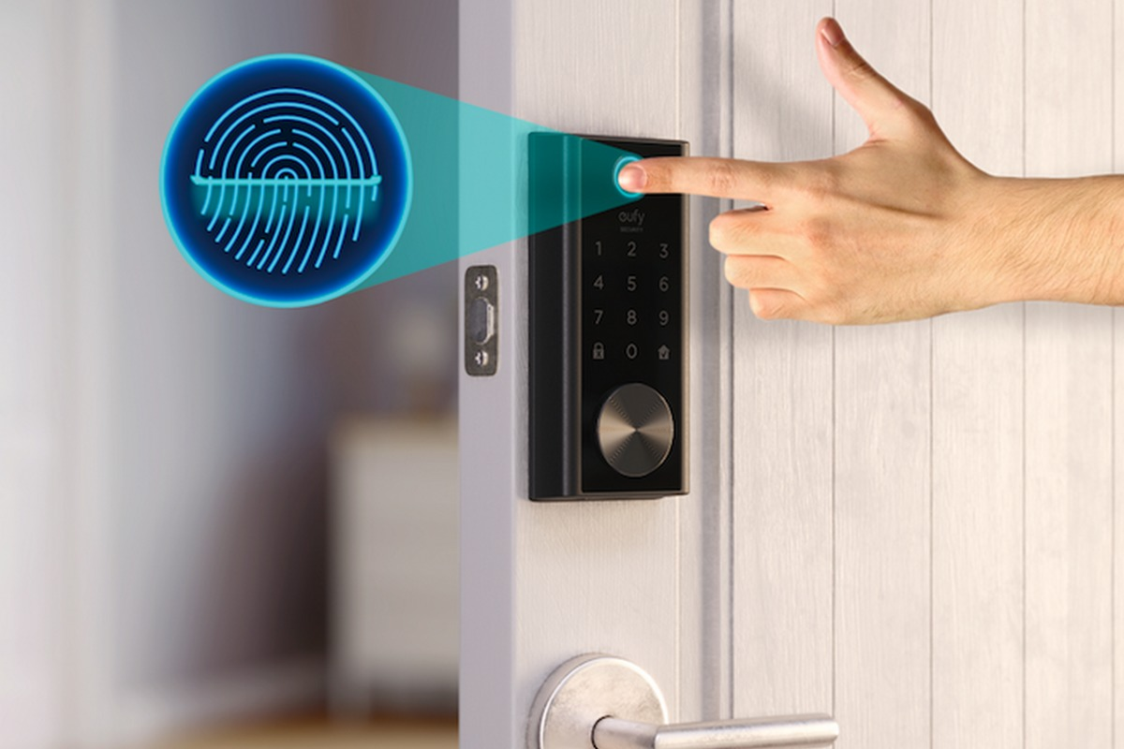
Tools for Confidentiality
Physical security: the establishment of physical barriers to limit access to protected computational resources.
Such barriers include locks on cabinets and doors, the placement of computers in windowless rooms, the use of sound dampening materials, and even the construction of buildings or rooms with walls incorporating copper meshes (called Faraday cages) so that electromagnetic signals cannot enter or exit the enclosure.

Slide 34

Integrity
Integrity: the property that information has not be altered in an unauthorized way.
Data Integrity can be compromised:
Bits flipped because of EMI, disk drive crash, human error, malware, insider threats, compromised hardware etc
Tools:
Backups: the periodic archiving of data. Altered? ->Restore
Checksums: the computation of a function that maps the contents of a file to a numerical value.
A checksum function depends on the entire contents of a file and is designed in a way that even a small change to the input file (such as flipping a single bit) is highly likely to result in a different output value.
Data correcting codes: methods for storing data in such a way that small changes can be easily detected and automatically corrected.
It’s not just the content of the file that needs to be maintained with respect to integrity
We also need to protect metadata for each data file.

Slide 35
Availability
Availability: the property that information is accessible and modifiable in a timely fashion by those authorized to do so.
The quality of information is associated with how available it is.
A thief who steals lots of credit cards might wish to attack the availability of the list of stolen credit cards that is maintained and broadcast by a major credit card company
Tools:
Physical protections: infrastructure meant to keep information available even in the event of physical challenges. –withstand storms, earthquakes, bomb blasts, have generators etc
Computational redundancies: computers and storage devices that serve as fallbacks in the case of failures.
Ex. RAID, redundant servers (web farms etc)
There are a number of additional concepts that are also important in modern computer security application: Authenticity, Assurance and Anonymity

Slide 36
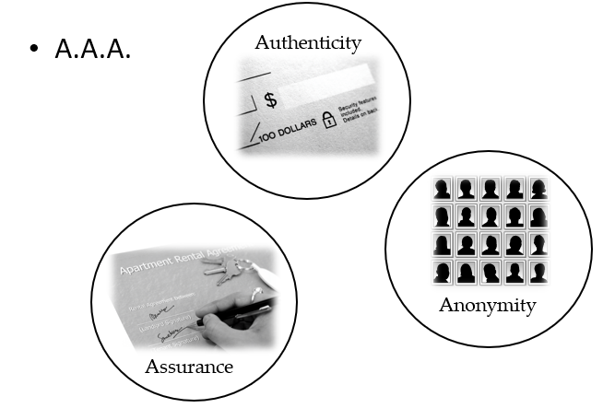
Other Security Concepts

Slide 37
Assurance
Assurance refers to how trust is provided and managed in computer systems.
To ensure trust, we first specify
policies — Specifications of how people/systems are expected to behave;
permissions — Descriptions of actions that people/systems are allowed to perform.
Then we put in place
Protections — Mechanisms that enforce policies and permissions.

Slide 38
Assurance Example – Apple itunes
Apple defines policies for buying/downloading/playing/copying songs.
Apple grants permission to access a song Bob has paid for.
Apple uses DRM (Digital Rights Management) technologies to protect against illegal copying.
Bob expects Apple to abide by its policy for handling credit cards.
Bob grants Apple permission to charge $.99 to his credit card when he buys a song.
Bob has a protection agreement with Visa so that he’s not charged if his card is stolen.

Slide 39
Authenticity
Authenticity is the ability to determine that statements, policies, and permissions issued by persons or systems are genuine.
We need to be able to enforce contracts.
We cannot enforce the contract unless we know it’s genuine.
Nonrepudiation: The property that authentic statements issued by a person or system cannot be denied.
A person could claim they didn’t sign a contract, or say it was signed by someone else.

Slide 40
Authenticity: Mechanisms
Blue-ink signatures — achieves nonrepudiation by allowing a person to commit to the authenticity of a document, by signing their name on it.
Digital signatures — achieves nonrepudiation for digital documents, using cryptography

Slide 41
Anonymity
Anonymity: the property that certain records or transactions not to be attributable to any individual.
Our identity is tied to the online transactions we perform:
medical records
purchases
legal records
Email
browsing history

Slide 42
Anonymity: Mechanisms
Aggregation — merging data from many people, but only when sums/averages can’t be mined for an individual’s information.
Mixing — randomly merging different streams of transactions, information, communications so that they can be queried/searched/. . . but no information about an individual can be extracted.
Proxies — trusted agents performing actions on behalf of a person, such that it can’t be traced back to that individual.
Pseudonyms — fake identities used in online communication, such that only a trusted party knows the connection to the real identity.

Slide 43
Anonymity: Examples — U.S. Census
The Census publishes data (race, ethnicity, gender, age, salary) by zip-code.
They won’t publish the information if it would expose details about an individual.

Slide 44
Anonymity: Examples — https://www.torproject.org
Instead of taking a direct route from source to destination, data packets on the Tor network take a random pathway through several relays that cover your tracks so no observer at any single point can tell where the data came from or where it’s going.
Individuals use Tor to keep web sites from tracking them and their family members, or to connect to news sites, instant messaging services, or the like when these are blocked by their local Internet providers.
Journalists use Tor to communicate more safely with whistleblowers and dissidents.
Law enforcement uses Tor for visiting or web sites without leaving government IP addresses in their web logs, and for security during sting operations.

Slide 45
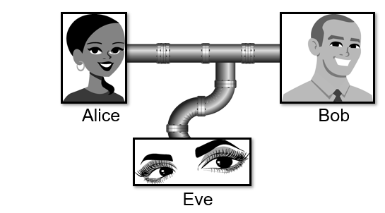
Threats and Attacks
Eavesdropping: the interception of information intended for someone else during its transmission over a communication channel.
Packet sniffer (monitor nearby internet traffic)
Tcpdump, wireshark etc
This is an attack on___________.

Slide 46
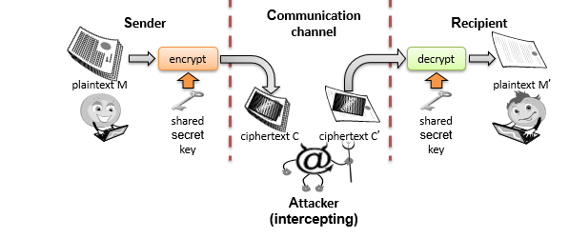
Threats and Attacks
Alteration: unauthorized modification of information.
Example: the man-in-the-middle attack, where a network stream is intercepted, modified, and retransmitted.
Computer viruses, which modify critical system ﬁles so as to perform some malicious action and replicate themselves
Cracking: tamper with an application to remove a license check
This is an attack on _______________

Slide 47
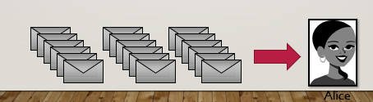
Threats and Attacks
Denial-of-service: the interruption or degradation of a data service or information access.
Example:
email spam, to the degree that it is meant to simply fill up a mail queue
DDOS : A botnet floods amazon.com with packets to prevent you from buying books
Denial of service is an attack on _________

Slide 48
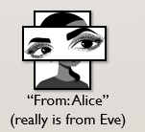
Threats and Attacks
Masquerading: the fabrication of information that is claimed to be from someone who is not actually the author.
Ex. phishing, which creates a website that looks like a real bank or another e-commerce site, but is intended only for gathering passwords,
Bank0fAmerica.com looks like BankOfAmerica.com but isn’t
Tax phishing campaign – impersonation of legitimate tax authorities made the users trust a URL attachments
Spooﬁng, which may involve sending on a network data packets that have false return addresses.
Masquerading is an attack on authenticity

Slide 49
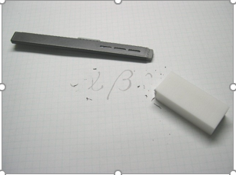
Threats and Attacks
Repudiation: the denial of a commitment or data receipt.
Repudiation threats are associated with users who deny performing an action without other parties having any way to prove otherwise.
for example, a user performs an illegal operation in a system that lacks the ability to trace the prohibited operations
a customer sends a letter to a vendor agreeing to pay a large amount of money for a product.
If the vendor cannot prove that the letter came from the customer, the attack succeeds.
This is an attack on ____________

Slide 50
Threats and Attacks
Correlation and traceback: the integration of multiple data sources and information flows to determine the source of a particular data stream or piece of information.
This is an attack on ________
Bob

Slide 51
Assignment
#1 ICS Insider
#2 IT Insider
#3 Common Ransomware
#4 Targeted Ransomware
#5 Zero-Day Ransomware
#6 Ukrainian Attack
#7 Sophisticated Ukrainian Attack
#8 Market Manipulation
#9 Sophisticated Market Manipulation
#10 Cell-phone WIFI
#11 Hijacked Two-Factor
#12 IIoT Pivot
#13 Malicious Outsourcing
#14 Compromised Vendor Website
#15 Compromised Remote Site
#16 Vendor Back Door
#17 Stuxnet
#18 Hardware Supply Chain
#19 Nation-State Crypto Compromise
#20 Sophisticated Credentialed ICS Insider

Slide 52
Security Design Principles

Slide 53
Economy of mechanism
This principle stresses simplicity in the design and implementation of security measures.
If the design and implementation are simple, fewer possibilities exist for errors.
The checking and testing process is less complex
Economy of mechanism is thus closely related to implementation and usability issues

Slide 54
Fail-safe defaults
The Principle of Fail-Safe Defaults states that, unless a subject is given explicit access to an object, it should be denied access to that object.
This principle requires that the default access to an object is none.
Whenever access, privileges, or some security-related attribute is not explicitly granted, it should be denied.
Further, if the subject is unable to complete its action or task, before the subject terminates, it should undo those changes it made to the security state of the system.
This way, even if the program fails, the system is still safe.
Notes:
Bank to bank transaction: CBE to CBO – password, select CBO, enter the money, then takes it from CBE and then when it’s about to store it to CBO network fails – what happens?

Slide 55
Complete mediation
This principle restricts the caching of information, which often leads to simpler implementations of mechanisms.
Every time someone tries to access an object, the system should authenticate the privileges associated with that subject.
What happens in most systems is that those privileges are cached away for later use.
The subject’s privileges are authenticated once at the initial access.
For subsequent accesses, the system assumes that the same privileges are enforced for that subject and object.
This may or may not be the case.
The operating system should mediate all and every access to an object.
e.g. DNS/ARP information is cached What if it is poisoned?

Slide 56
Open design
According to this principle, the security architecture and design of a system should be made publicly available.
Security should rely only on keeping cryptographic keys secret.
Open design allows for a system to be scrutinized by multiple parties, which leads to the early discovery and correction of security vulnerabilities caused by design errors.
The open design principle is the opposite of the approach known as security by obscurity, which tries to achieve security by keeping cryptographic algorithms secret and which has been historically used without success by several organizations.

Slide 57
Separation of privilege
This principle dictates that multiple conditions should be required to achieve access to restricted resources or have a program perform some action.
the term has come to also imply a separation of the components of a system, to limit the damage caused by a security breach of any individual component.
Ex
Separating various administrative account functions from each other
Separating administrative and standard account capabilities
Separating auditing and logging capabilities within administrative accounts

Slide 58
Least privilege
The Principle of Least Privilege means that you ensure people only have enough access that they need to do their job.
For instance: if you design a system that holds sensitive customer financial information, it’s good practice to limit who can access that information.
The person who answers the phone and schedules meetings probably doesn’t need access to all of the sensitive information.
On the other hand, an account manager probably does need access to that information.
The key is to ensure that the account manager doesn’t have access to information from accounts they don’t manage.
By ensuring that accounts have only the privileges necessary to do their job, you ensure that if an attacker compromises an account, you minimize what information they can access.
This limits the damage of the attack.

Slide 59
Least common mechanism
In systems with multiple users, mechanisms allowing resources to be shared by more than one user should be minimized.
For example, if a file or application needs to be accessed by more than one user, then these users should have separate channels by which to access these resources, to prevent unforeseen consequences that could cause security problems.
If one program can corrupt the shared state, it can then corrupt other programs which depend on it.

Slide 60
Psychological acceptability
The principle of psychological acceptability states that security mechanisms should not make the resource more difficult to access than if the security mechanisms were not present.
the principle is interpreted to mean that the security mechanism may add some extra burden, but that burden must be both minimal and reasonable
Configuring and executing a program should be as easy and as intuitive as possible, and any output should be clear, direct, and useful.
If a password is rejected, the password changing program should state why it is rejected rather than giving a cryptic error message.
On the other hand, security requires that the messages impart no unnecessary information
When a user supplies the wrong password during login, the system should reject the attempt with a message stating that the login failed.
If it were to say that the password was incorrect, the user would know that the account name was legitimate.
If the user were really an unauthorized attacker, s/he now knows an account for which she can try to guess a password.

Slide 61
Access Control Models

